Slide 1
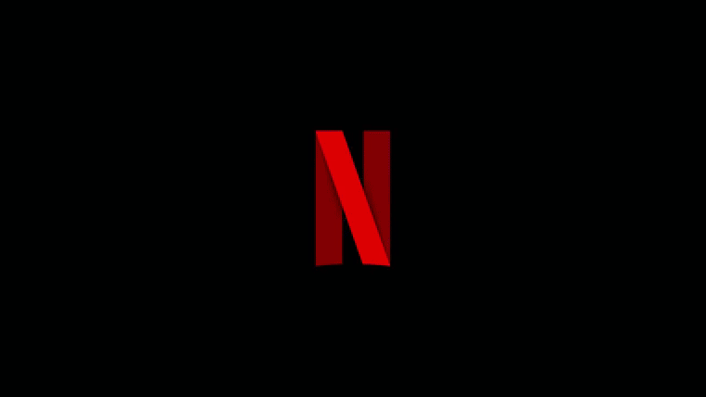

Slide 2
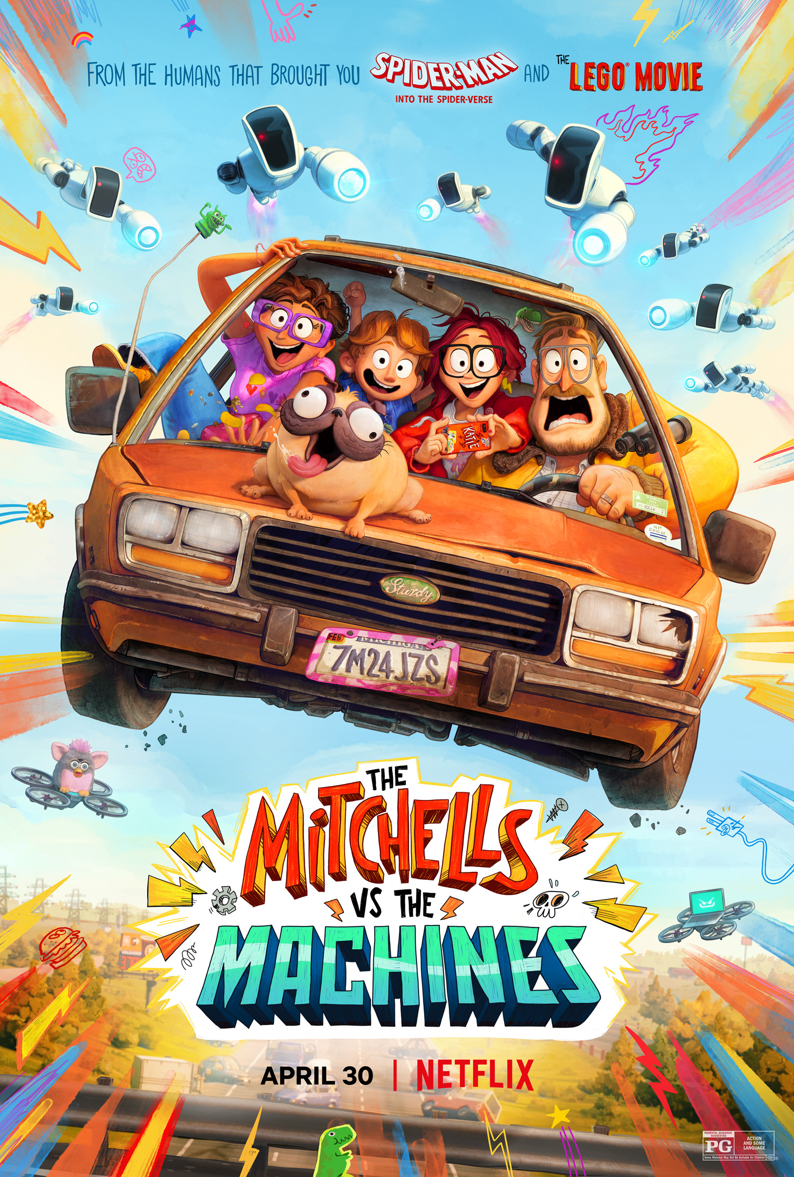

Home TV Shows Movies Recently Added My List
KIDS DVD
Netflix & IMDB EDA
2021
TV-PG
This project analyzed Netflix & IMDB data to answer the question " Does Runtime have an positive effect on IMDB Ratings?
▶ PLAY
+ MY LIST
Staring: Sarah C, Eli S, & Erin W.
Notes:
Creative Commons Attribution-NonCommercial-ShareAlike 4.0 International
EdTechPicks.org 2019-11-02

Slide 3
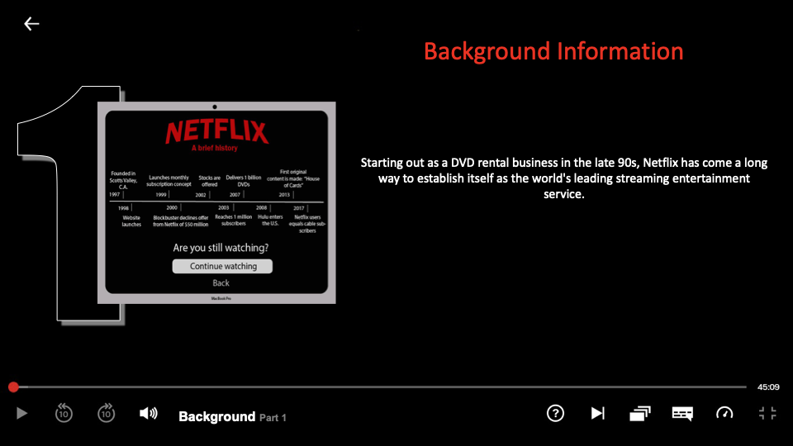
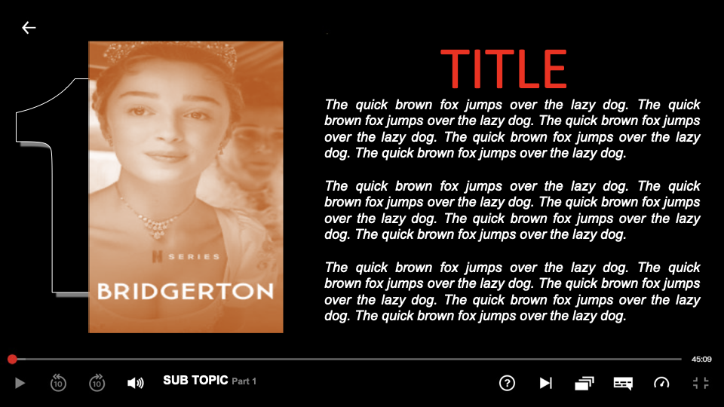
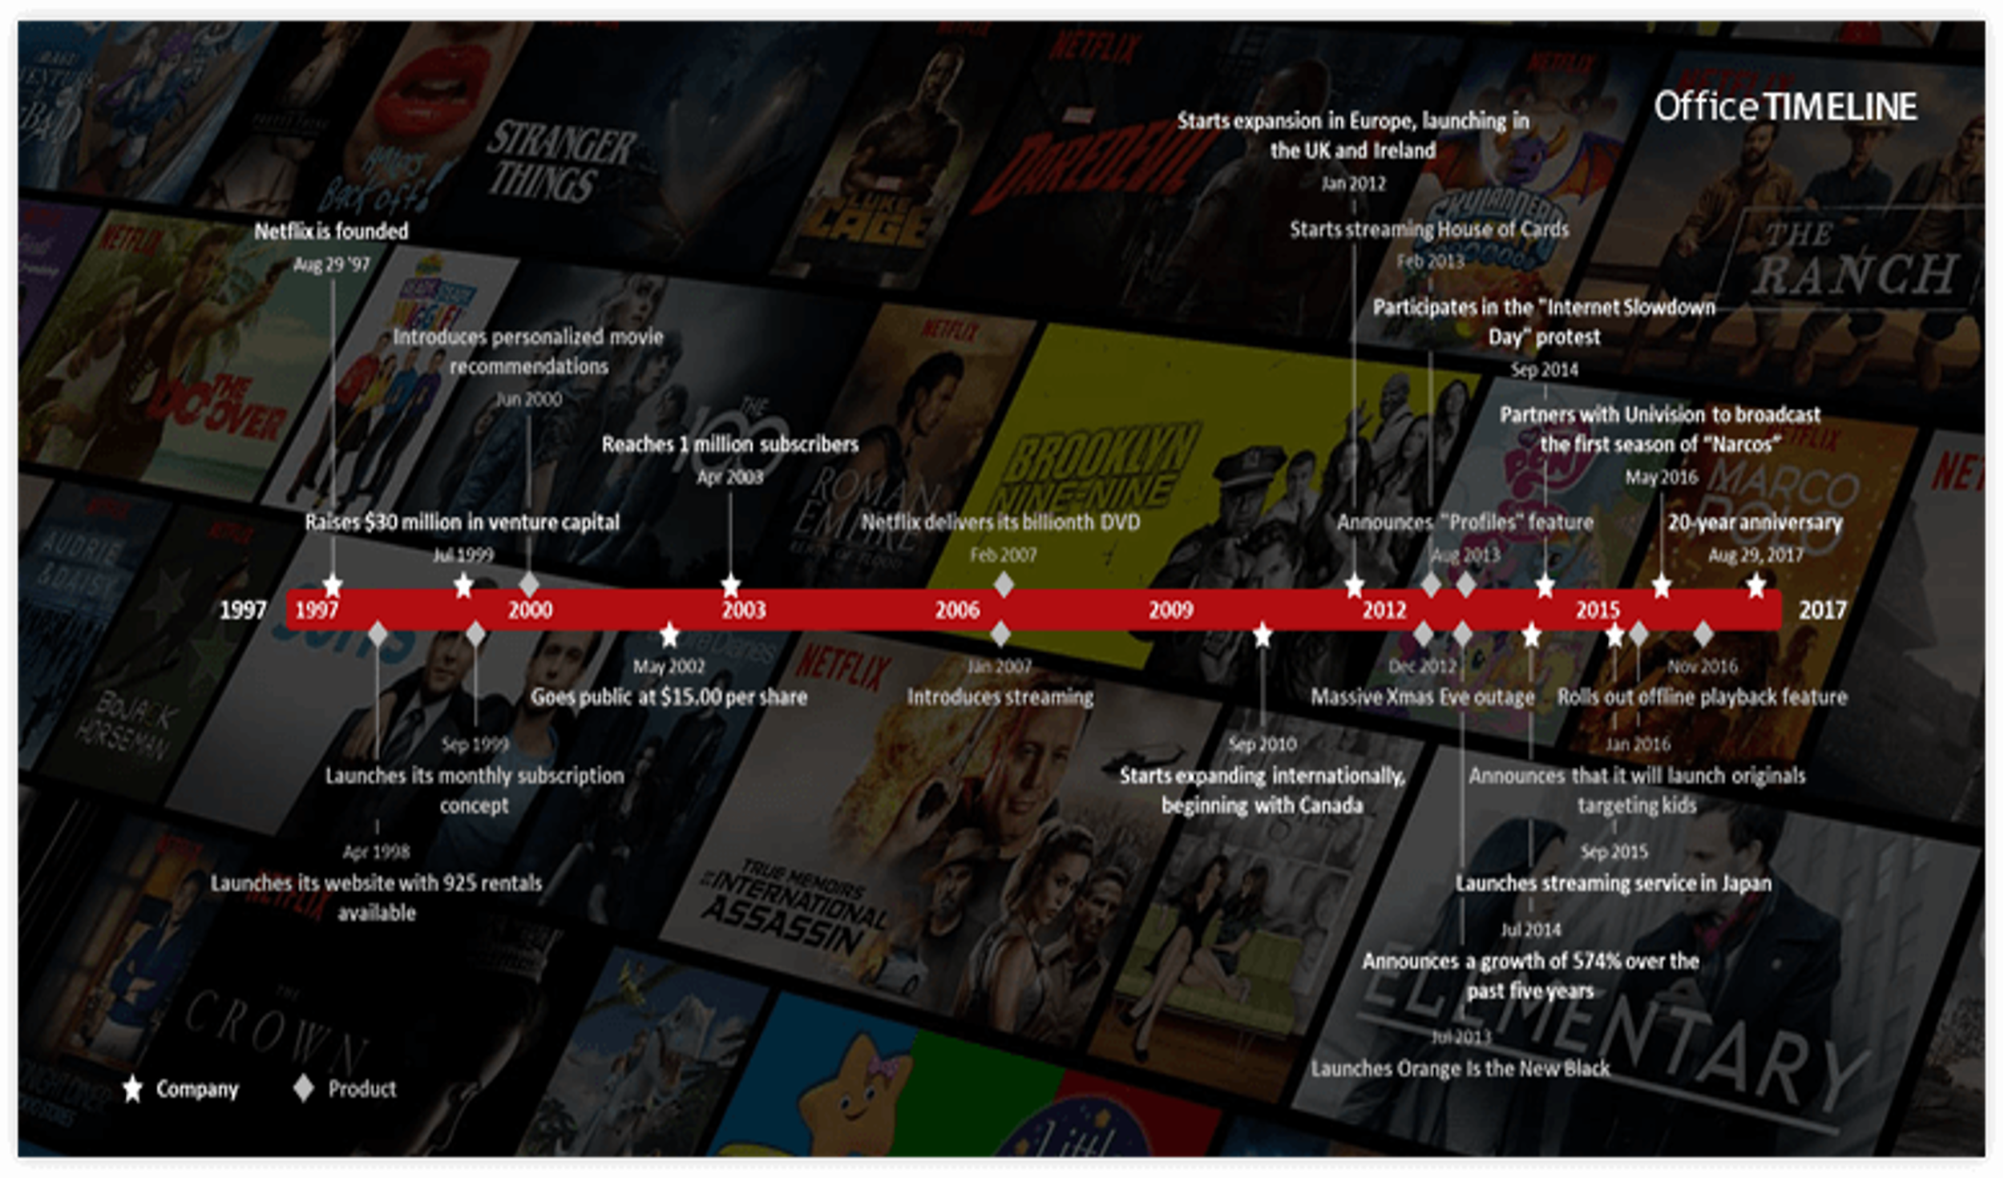
Home TV Shows Movies Recently Added My List
KIDS DVD
Background
Add Trailer Title Here
Notes:
Erin Slide: Information and Background

Slide 4
Home TV Shows Movies Recently Added My List
KIDS DVD
Research Questions
Does Runtime have an positive effect on IMDB Ratings?
What effect does digital movies vs. video movies have on IMDB Ratings?
What effect does ratings have on certain release years, and does it have a correlation to higher IMDB ratings?
Does TV series Genres have higher IMDB ratings than Movie Genre?
Notes:
This is a background slide, we can add what points we want to talk about tomorrow morning.

Slide 5
Home TV Shows Movies Recently Added My List
KIDS DVD
Research Methods
Topic: | Exploratory Data Analysis of Netflix IMDB Scores
Research Philosophy: | Epistemology, Positivism
Research Approach: | Deductive
Methodology: | Secondary
Method: | Quantitative
Data Collection Technique or Strategy: | Case study
Analysis Technique: | Statistical Data Analysis
Recommended Software: | Anaconda, Jupiter Notebook, Python 3, Pandas, & Matlibplot
Notes:
This is a background slide, we can add what points we want to talk about tomorrow morning.

Slide 6
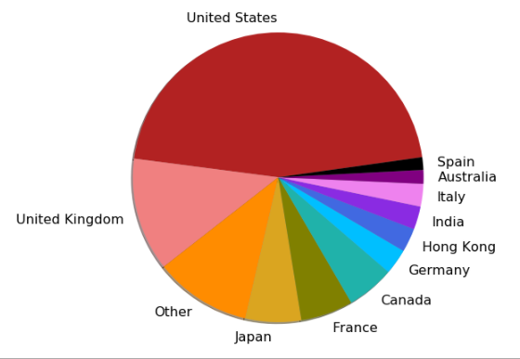
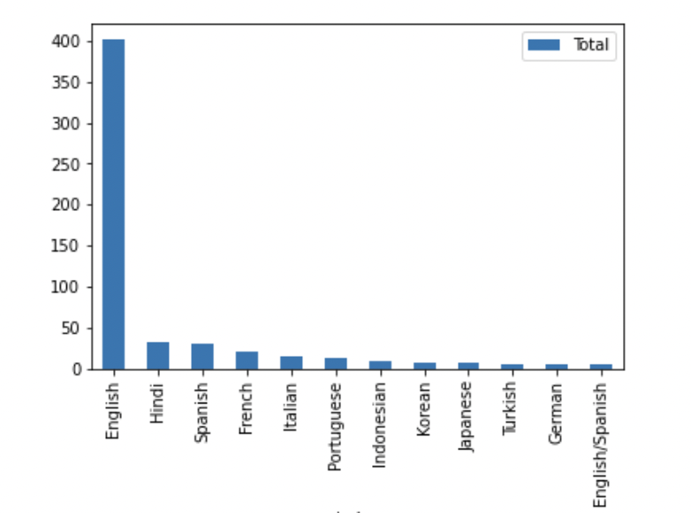
Home TV Shows Movies Recently Added My List
KIDS DVD
Country & Languages
Distribution of Movies by Year
Most Common Language used in Netflix
Most content come from the United States. A majority of it it from English speaking countries.
Netflix's most prolific content creators are mostly from the United States, with India and the United Kingdom well behind.Because Netflix is based in the United States, it's not surprising that the country creates the most material.
There are hundreds of countries in the world that rightfully have their own traditions, their own culture and their own languages. Unfortunately not all films are so famous that they are translated for everyone.
Notes:
Creative Commons Attribution-NonCommercial-ShareAlike 4.0 International
EdTechPicks.org 2019-11-02

Slide 7
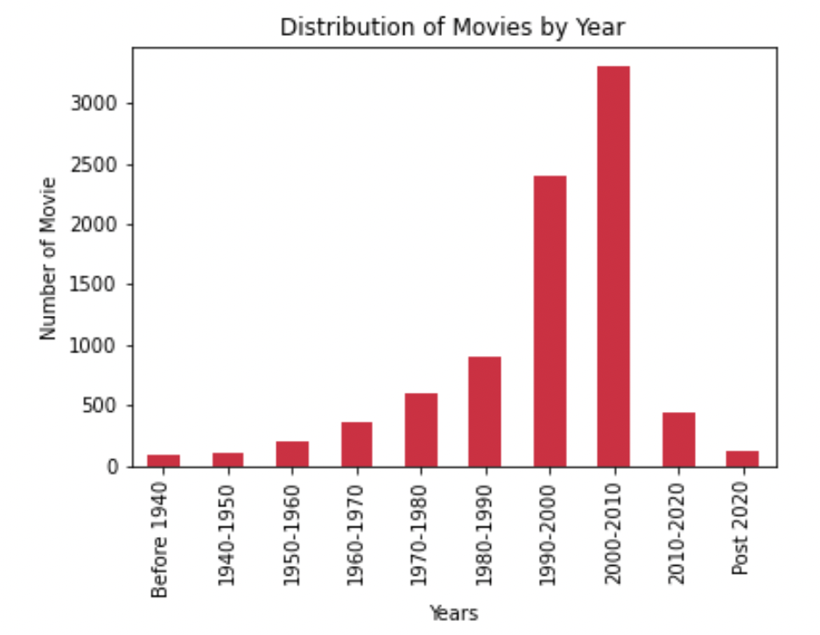
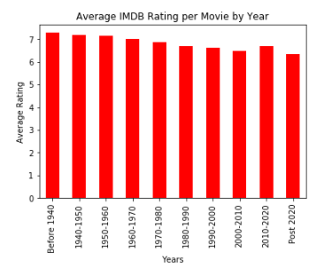
Home TV Shows Movies Recently Added My List
KIDS DVD
Our Findings
Season 1
Notes on Data:
Netflix started in 1997.
IMDB started in 1990.
Distribution of Movies by Year
Average Rating of Movies by Year
Looking at the distribution of content on Netflix, most of it is from the years 2000-2010.
Ratings seem to be gently decreasing as the years go on.
Notes:
Creative Commons Attribution-NonCommercial-ShareAlike 4.0 International
EdTechPicks.org 2019-11-02

Slide 8
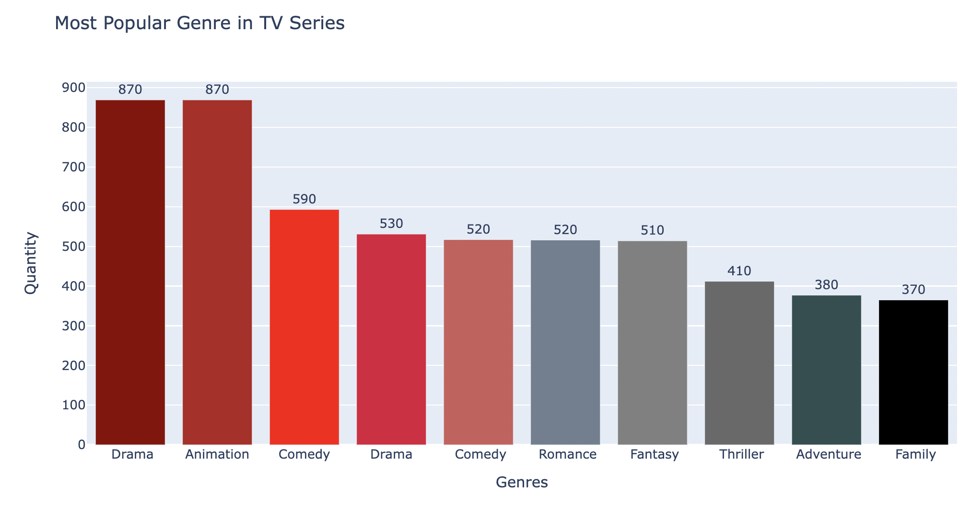
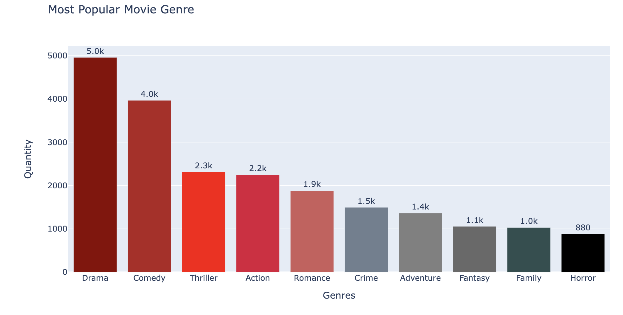
Home TV Shows Movies Recently Added My List
KIDS DVD
Our Findings
Season 1
Genre TV Series has higher IMDB ratings than Movie Genre.
Most Popular Genre in TV series
Most Popular Genre in Movies
Based off the IMDB Score the most popular genre in TV Series are Drama & Animation.
Based off the IMDB Score the most popular genre in Movies is Drama.
Notes:
Creative Commons Attribution-NonCommercial-ShareAlike 4.0 International
EdTechPicks.org 2019-11-02

Slide 9
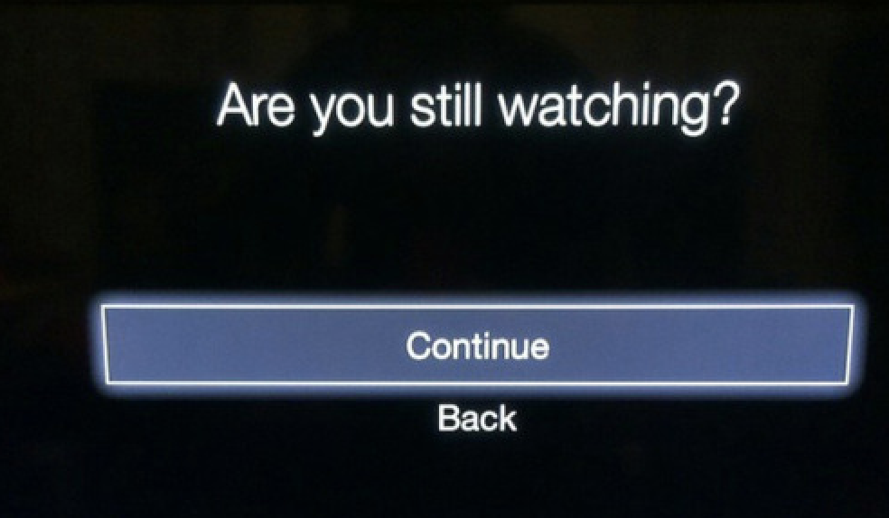
Home TV Shows Movies Recently Added My List
KIDS DVD
Notes:
This is a background slide, we can add what points we want to talk about tomorrow morning.

Slide 10
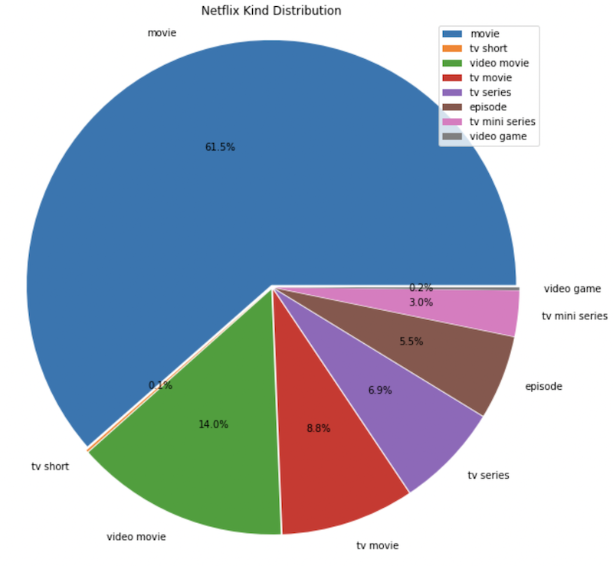
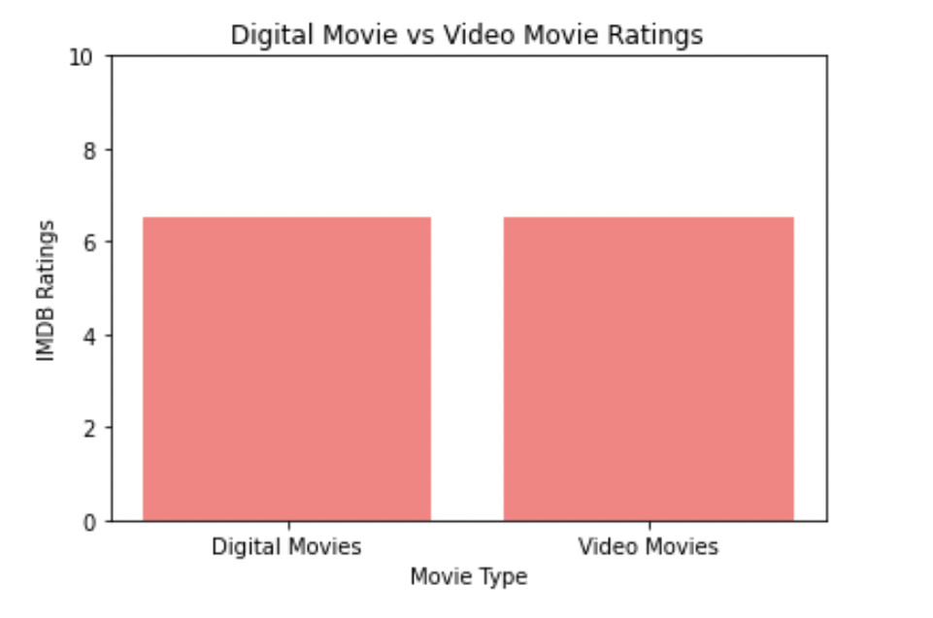
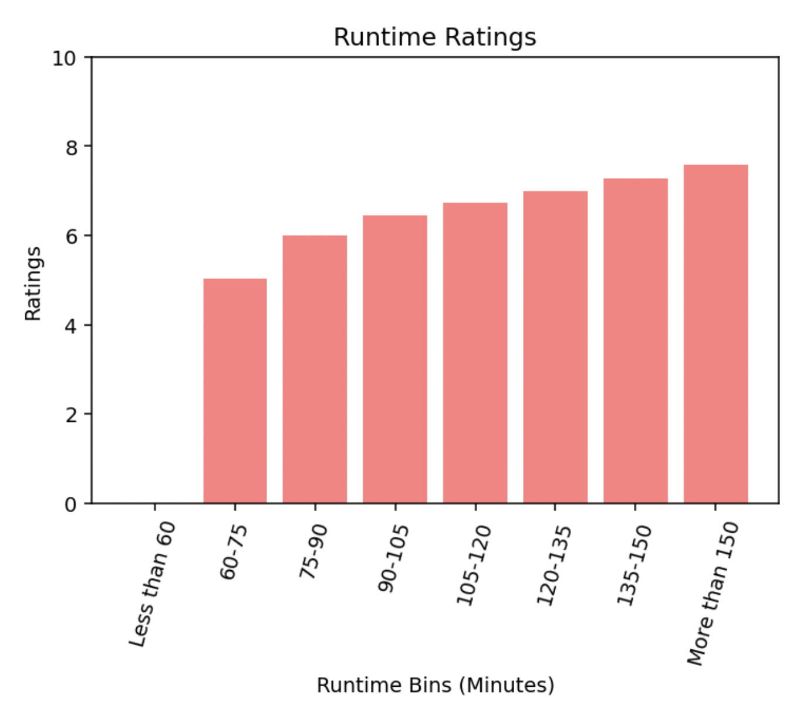
Home TV Shows Movies Recently Added My List
KIDS DVD
Our Findings
Netflix Kind Distribution
Digital Movie vs. Movie Rating
Runtime Rating
Looking at the distribution of video kind Netflix’s content is more than 75% movies.
There are no outstanding differences in IMDB ratings between Digital and Video Movies.
In regards to movies of any kind, there is a positive correlation between runtime and IMDB ratings.
Notes:
Creative Commons Attribution-NonCommercial-ShareAlike 4.0 International
EdTechPicks.org 2019-11-02

Slide 11
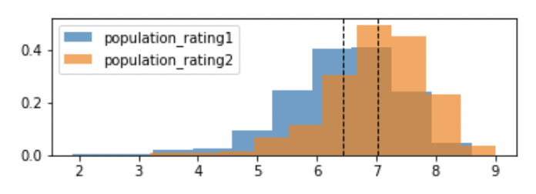
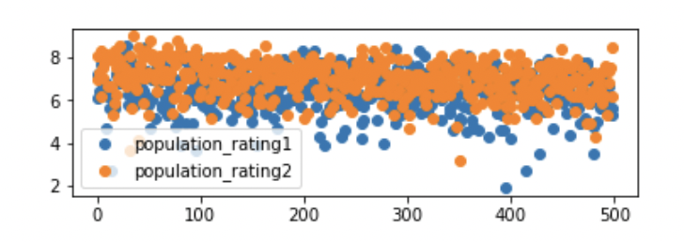
Home TV Shows Movies Recently Added My List
KIDS DVD
Statistical Analysis
Histogram
Scatter Plot
Legend Details:
Population_rating1 = Ratings of Movies under 2 hours
Population_rating2 = Ratings of Movies over 2 hours
Notes:
Creative Commons Attribution-NonCommercial-ShareAlike 4.0 International
EdTechPicks.org 2019-11-02

Slide 12
Home TV Shows Movies Recently Added My List
KIDS DVD
Conclusion
While researching the Netflix IMDB data we were successful in answering our research questions. Our analysis indicates there’s strong evidence for our hypothesis, which means Runtime does have a positive correlation with IMDB Ratings. This proves that movies under 2 hours has high IMDB ratings than movies over 2 hours.
There was no statistical difference in movies that were watched digitally versus movies that were watched on VHS.
There is a spike in in average ratings for Movies from years 2010-2020, we can contribute this to 2 historical events in Netflix history. They started marking with smart TV companies, and they started to release original Netflix material. This lets us know there is a correlation between IMDB ratings and Release Years.
TV genres tend to have a higher rating than movie genre.
Notes:
Creative Commons Attribution-NonCommercial-ShareAlike 4.0 International
EdTechPicks.org 2019-11-02

Slide 13
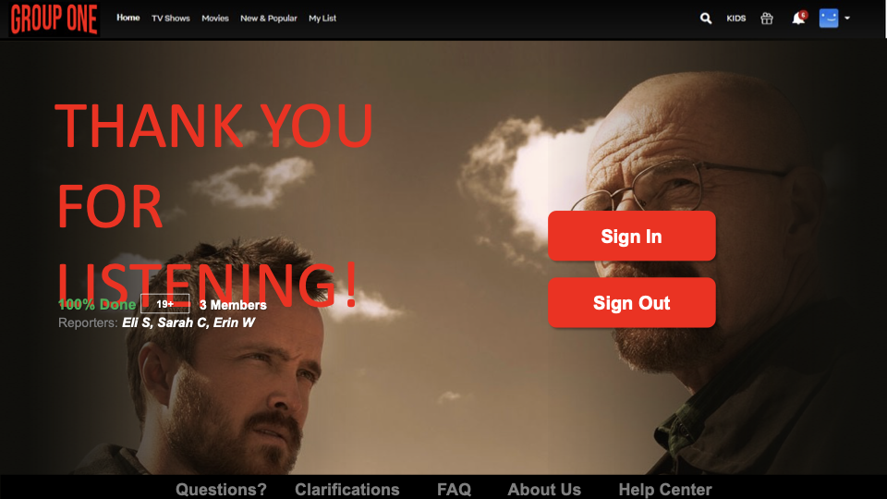

Slide 14
Home TV Shows Movies Recently Added My List
KIDS DVD
References
Butler, D. (1970, January 1). History Of Netflix: Timeline And Facts. TheStreet. https://www.thestreet.com/technology/history-of-netflix-15091518
DDangDeveloper. (2021, October 15). Netflix Prize Shows Information - EDA. https://www.kaggle.com/ddangdeveloper/netflix-prize-shows-information-eda/data
Notes:
Creative Commons Attribution-NonCommercial-ShareAlike 4.0 International
EdTechPicks.org 2019-11-02

Slide 15

Home TV Shows Movies Recently Added My List
KIDS DVD
Questions?
Notes:
Creative Commons Attribution-NonCommercial-ShareAlike 4.0 International
EdTechPicks.org 2019-11-02

